Slide 1
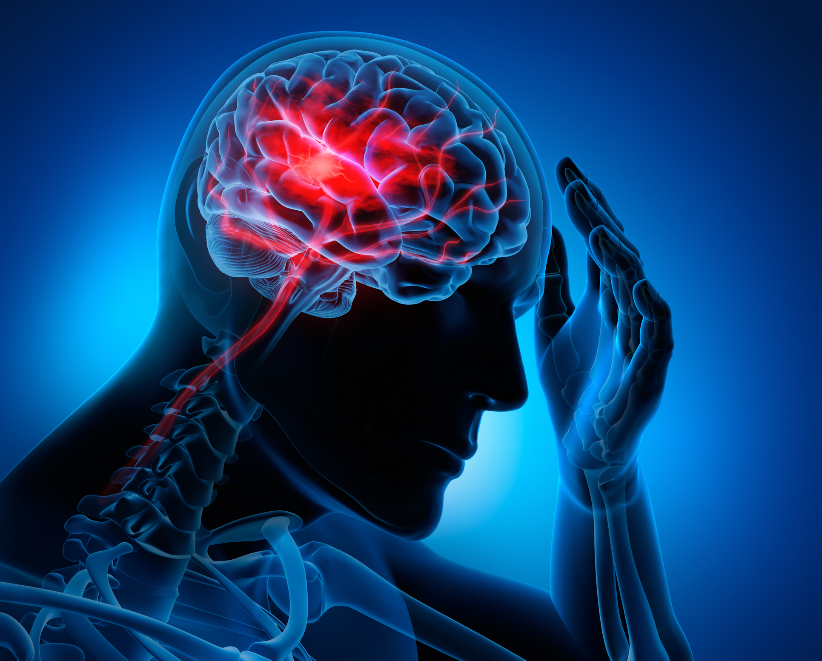

STROKE PREDICTION
Presented by:
Owen Muriithi

Slide 2
Introduction
A stroke occurs when a blockage or bleed of the blood vessels either interrupts or reduces the supply of blood to the brain. When this happens, the brain does not receive enough oxygen or nutrients, and brain cells start to die.
A stroke is a cerebrovascular disease. This means that it affects the blood vessels that feed the brain oxygen. If the brain does not receive enough oxygen, damage may start to occur.
This is a medical emergency. Although many strokes are treatable, some can lead to disability or death.
Symptoms of stroke include trouble walking, speaking and understanding, as well as paralysis or numbness of the face, arm or leg.
According to the World Health Organization (WHO) strokes are the 2nd leading cause of death globally; responsible for approximately 11% of total deaths.
In this presentation, we shall look into the factors affecting the probability of getting a stroke and also find out the best model that can be used to predict this probability.

Slide 3
Motivation
Dataset used: Stroke Prediction Dataset
From the data:
Stroke positive cases are more in older people than younger people
People with a high BMI also account for most of the positive stroke cases.
We shall look into the factors given in this dataset and how they affect the likelihood of a stroke, and use these factors to predict the likelihood of getting a stroke.

Slide 4
Descriptive Statistics
The dataset consists of 1 csv of 5109 records with 12 features made up of numerical and binary features as follows :
  Numerical features: id – index value, age – age of the person , BMI – Body mass index, avg_glucose_levels – blood sugar levels.
  Binary features:
      Gender – gender of the person (Male, Female, Other)
      Hypertension – if the person has hypertension (0 – no, 1 - yes)
      Heart Disease – if the person has a heart disease (0 – no, 1 – yes)
      Ever_married – if the person has ever married (Yes, No)
      Work Type – the nature of the person’s work type (Private, Self-employed, Children, Govt_job, Never_worked)
      Residence type – nature of person’s residence (Urban, Rural)
      Smoking status – the smoking status of the person (Never smoked, Formerly smoked, Unknown, Smokes)
      Stroke – if the person got a stroke or not ( 0 – no, 1 – yes)
The dataset had 201 missing values for the BMI that were inputted by the mean BMI of the sample which was 28.9. It had only one ‘Other’ value of gender which was dropped along with the id column which was not relevant for our study. Below is a sample of the dataset after imputation:
Gender | Age | Hypertension | Heart_disease | Ever_married | Work_type | Residence_type | Avg_glucose_level | BMI | Smoking_status | Stroke
Male | 67.0 | 0 | 1 | Yes | Private | Urban | 228.69 | 36.6 | Formerly smoked | 1
Female | 61.0 | 0 | 0 | Yes | Self-employed | Rural | 202.21 | 28.9 | Never smoked | 1
Male | 80.0 | 0 | 1 | Yes | Private | Rural | 105.92 | 32.5 | Never smoked | 1

Slide 5
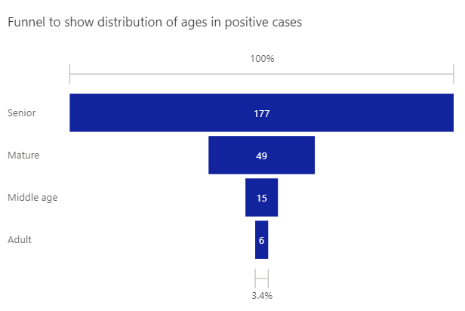
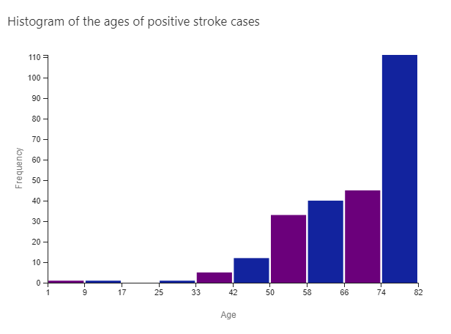
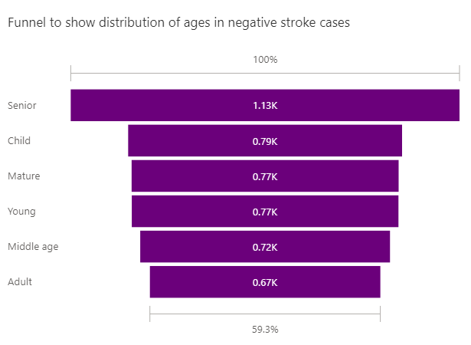
Age Analysis
Age group | Ranges
Child | 0-16
Young | 17-30
Adult | 31-40
Middle-age | 41-50
Mature | 51-60
Senior | 60 +
The first funnel chart here shows that the senior age group accounts for the most positive cases
The histogram above shows that 2 records are not within the distribution, we can drop them to have a more harmonious distribution
The second funnel chart here shows a more equally distributed age for the negative cases

Slide 6
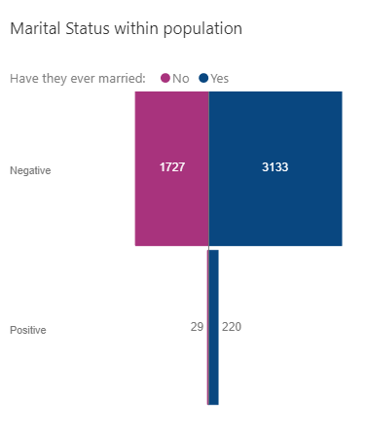
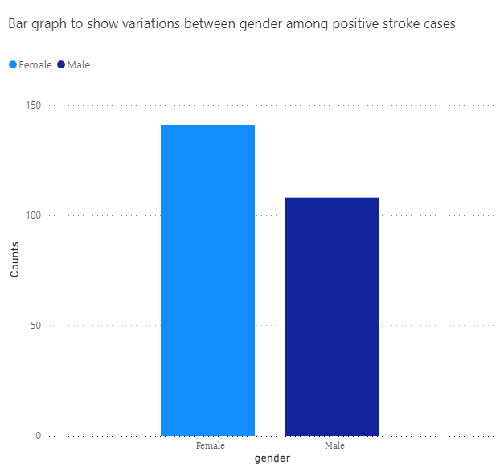
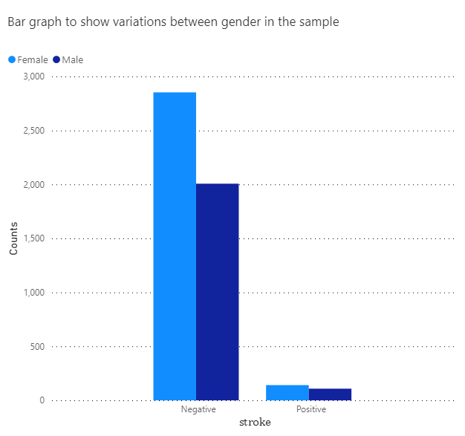
Gender and Marital Status Analysis
The bar graphs above show that the dataset has generally more women than men and also shows how heavily imbalanced the dataset is.
The tornado chart above shows that for both negative and positive stroke cases, most of the people had ever been married.

Slide 7
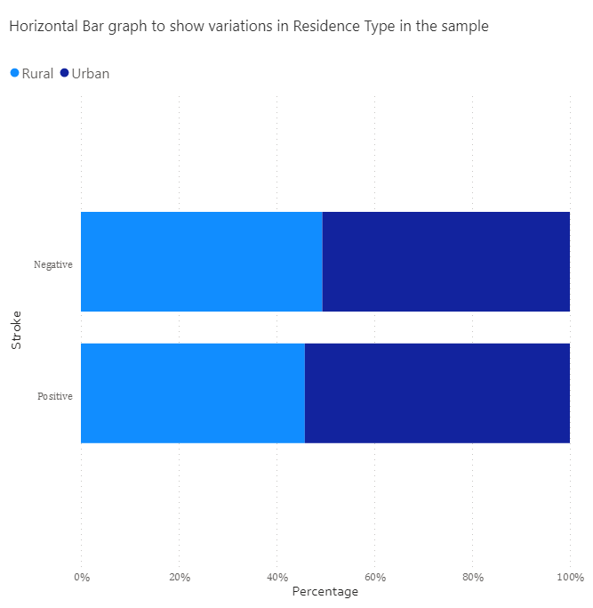
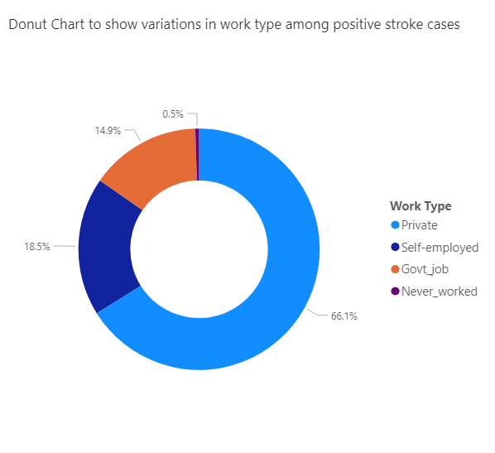
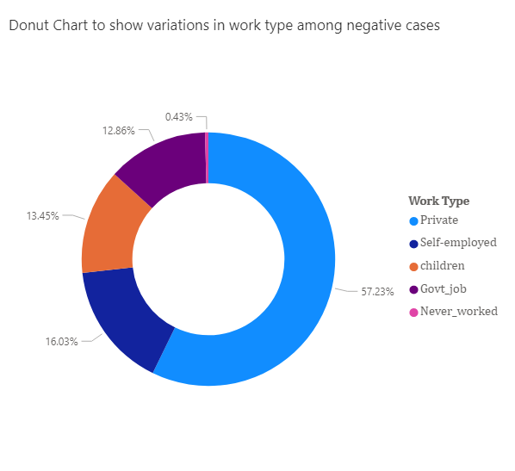
Work type and Residence type Analysis
The above Horizontal bar graph of Residence type shows that for both populations, most of the residence type is Urban.
The donut charts above show that most people have a Private work type but it’s worth noting that for the negative cases the category for ‘children’ exists and occupies 13.5% of the population unlike in the positive cases

Slide 8
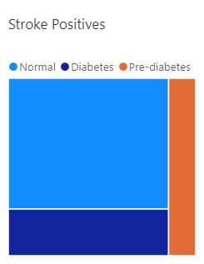
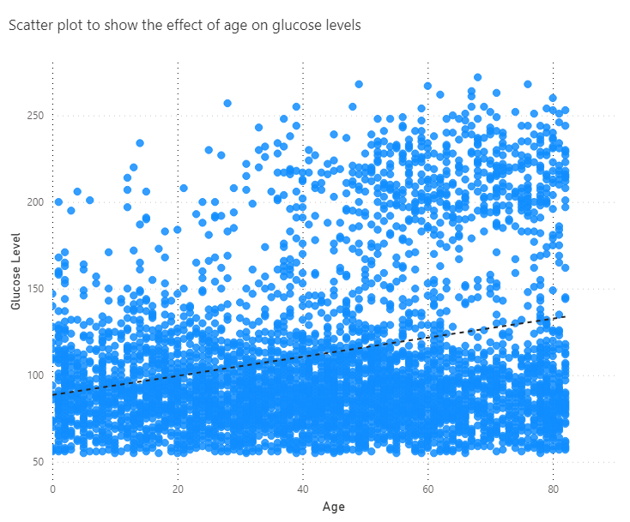
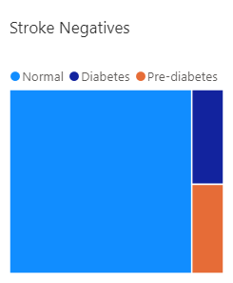
Average Glucose Level Analysis
Category | Range
Normal | 50 - 140
Pre-diabetes | 141 - 200
Diabetes | 200 +
The tree map on the left shows most stroke positive victims had normal blood sugar levels but a substantial portion had diabetes.
The tree map on the left shows most stroke negative cases had normal blood sugar with pre-diabetes and diabetes occupying a lower portion (almost equally.)
The scatter plot above shows that as age increases, so does the glucose levels.

Slide 9
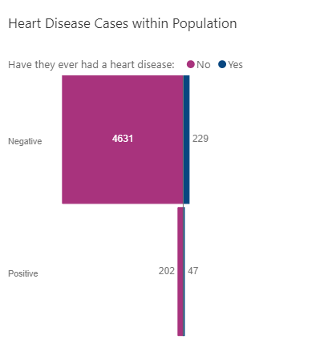
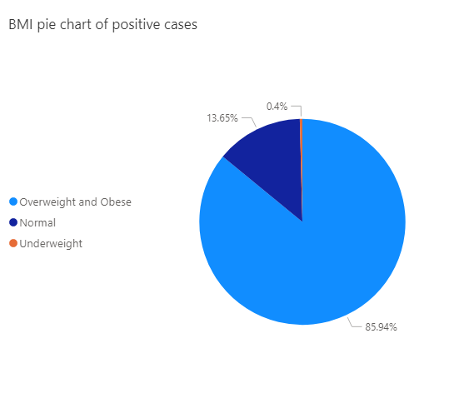
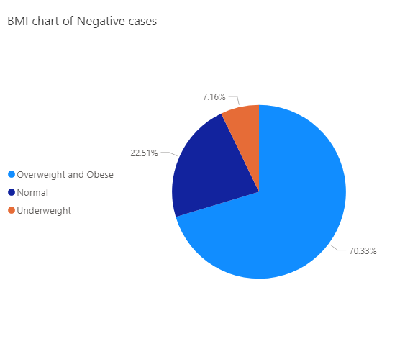
BMI and Heart Disease Analysis
Category | Range
Underweight | 10 - 18
Normal | 19 - 24
Overweight & Obese | 24 +
The tornado chart above shows that for both samples, most people did not have a heart disease
The above pie charts show that most people in both samples are overweight/obese but you will note that in the negative cases, the proportions of normal and underweight are more compared to in the positive cases.

Slide 10
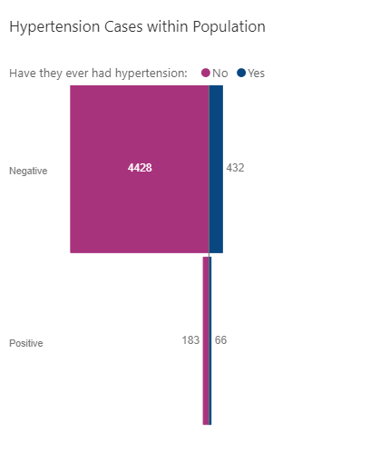
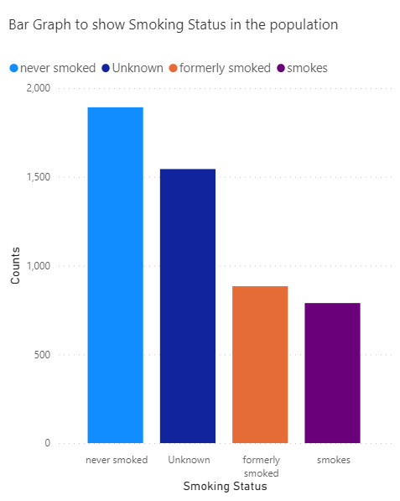
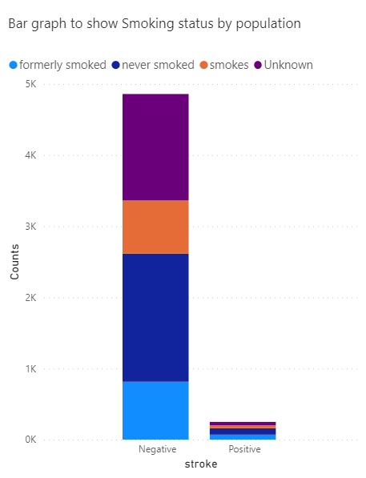
Hypertension and Smoking Status
Analysis
The above chart shows that for both positive and negative cases, most of the people did not have hypertension
This shows that generally most people from positive and negative cases are not smokers.

Slide 11
Research Question
From our data we notice:
  People of an older age have the most stroke positive cases.
  People with high BMI levels have the most stroke positive cases.
  The dataset is a binary type of dataset therefore for modelling we shall use classification algorithms to find the best model that can be used for prediction.
Therefore, our research questions are:
  Is there a significant difference between older men and older women who got a stroke?
  Is there a significant difference between overweight/obese men and overweight/obese women who got a stroke?
  What is the best model that can be used for stroke prediction?
Research methodology
To answer our questions we shall use hypothesis testing and for modelling we will try out the following classification methods: Logistic Regression, Random Forest, Naïve Bayes, KNN and Support Vector Classifier.
Details of the tests and modelling can be found in the attached notebook.

Slide 12
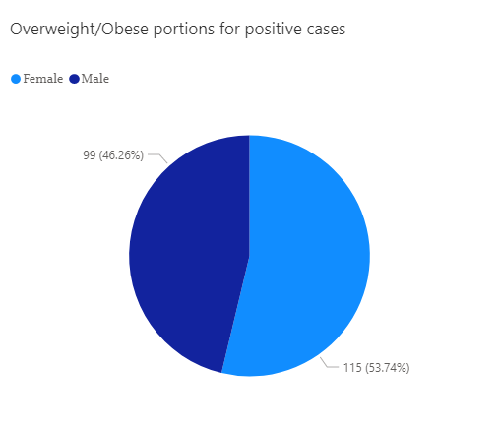
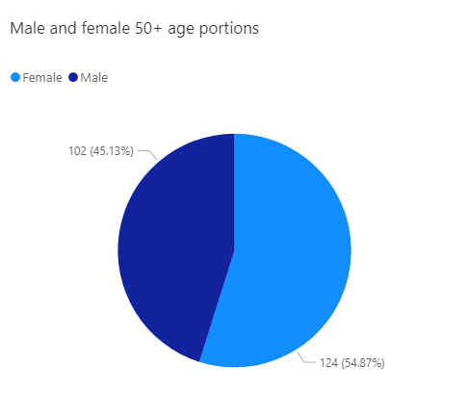
Hypothesis Testing
H₀: Overweight/obese men are just as likely to get a stroke as overweight/obese women.
H₀: Older men are as likely to get a stroke as older women.
H_{a}: Older men are not as likely to get a stroke as older women.
H_{a}: Overweight/obese men are not as likely to get a stroke as overweight/obese women.
H₀: p_{men} = p_{women}
H_{a}: p_{men} ≠ p_{women}
H₀: p_{men} = p_{women}
H_{a}: p_{men} ≠ p_{women}
Standard error of estimate: 0.0331
Test statistic: -2.9608
P-value: 0.0031
Significance level: 0.05
P-value < 0.05
Standard error of estimate: 0.0342
Test statistic: -2.0483
P-value: 0.0405
Significance level: 0.05
P-value < 0.05
The p-value is slightly lower than the significance level here.
The p-value is much lower than the significance level here.
We therefore reject the null hypothesis and accept the alternate
We therefore reject the null hypothesis and accept the alternate

Slide 13
Findings and Limitations
We set out to answer the following questions:
  Is there a significant difference between older men and older women who got a stroke?
  Is there a significant difference between Overweight/obese men and overweight/obese women who got a stroke?
  What is the best model that can be used for stroke prediction?
On hypothesis testing, we found that older men are not as likely to get a stroke as older women in fact they have a significantly less chance than older women. We also found that overweight/obese men are not as likely to get a stroke as overweight women but it was noted that the difference was minor.
Some limitations of using this dataset are:
  The smoking status column had a number of unknown values. Had we known these values, we would have had a more informed view on the effect of smoking on the results and this would make our model more accurate.
  The dataset does not contain a death tally. This would help us in determining the lethality of getting a stroke.
  The dataset does not categorize heavy drinking as a factor that can cause a stroke though excessive drinking of alcohol has been found to increase your risk of stroke by 5 times.

Slide 14
References
References used:
  Stroke information – For stroke medical information.
  Body Mass Index – Used to categorize BMI numerical values to known categories (underweight, normal, overweight and obese)
  Blood Sugar Levels – Used to categorize numerical blood glucose levels to know categories (normal, pre-diabetes and diabetes)
  Stroke Prediction Dataset – Dataset used.
  Power Bi – reports on the feature visuals used.

Slide 15
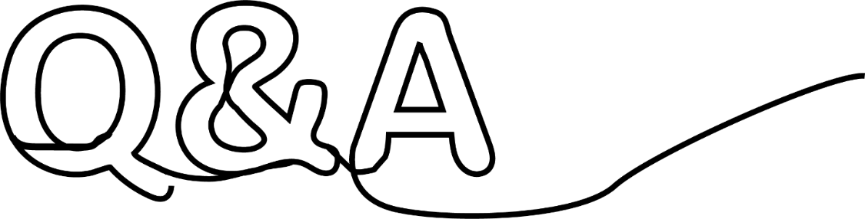
Q&A
Thank you

